Slide 1
Web Application Security
By –Prakash Khasor, Assistant Professor(Cyber Security), National Forensic Sciences University

Slide 2
Banner Grabbing
Banner grabbing is the act of getting software banner information (name and version), whether it’s done manually, or by using any OSINT tools that can do it for you automatically.
And its termed as Service FingerPrinting also.
Why Banner Grabbing?
Banner Grabbing allows an attacker to discover network hosts and running services with their versions on the open ports and moreover operating systems so that he can exploit the remote host server and Local Server.

Slide 3
Types of Banner Grabbing
Active Banner grabbing:− This is the most popular type of banner grabbing, basically the act of sending packets to the remote host and waiting for their response to analyze the data.
Passive Banner grabbing:− Passive banner grabbing enables you to get the same information while avoiding a high level of exposure from the origin connection. Different intermediate software and platforms can be used as a gateway to avoid a direct connection and still allow you to obtain the data you need.

Slide 4
SEC_TERMS
Exploit:-An Exploit is a tool that is used to manipulate the vulnerability. There can't be an exploit without first being a vulnerability.
Payload:-After the vulnerability is discovered, and exploit is created and used, then a payload can get loaded. The payload is a malicious program that allows hackers to obtain their objectives
Shellcode:-Shellcode is mainly a listing of fastidiously crafted instructions that may be executed as soon as the code is injected right into a working software.

Slide 5
TOOLS
Telnet
Wget
Curl
Netcat
Dmitry
Nikto
Nmap

Slide 6
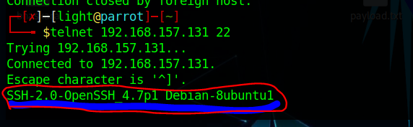
Telnet
Telnet is one of the most classic cross-platform clients available, one that allows you to interact with remote services for banner grabbing.
Syntax:- telnet IP PORT

Slide 7
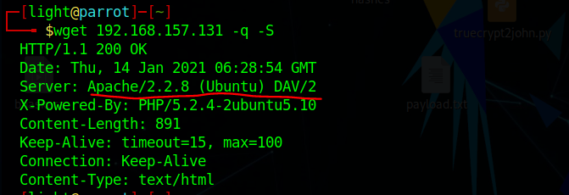
Wget
WGET is another that can help us to remote banner of any remote or local server.
Syntax:- wget IP –q –S
q- for the normal output
S- for print the headers sent by the HTTP server.

Slide 8
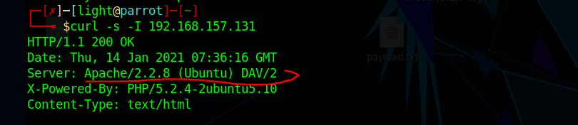
cURL
The cURL command includes the functionality for retrieving the banner details from HTTP servers. Just execute the following command
Syntax:- curl –s –I IP

Slide 9
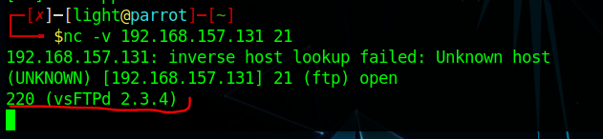
Netcat
Netcat is one of the oldest and most popular network utilities for Unix and Linux. For banner grabbing purposes
Syntax :- nc –v IP PORT

Slide 10
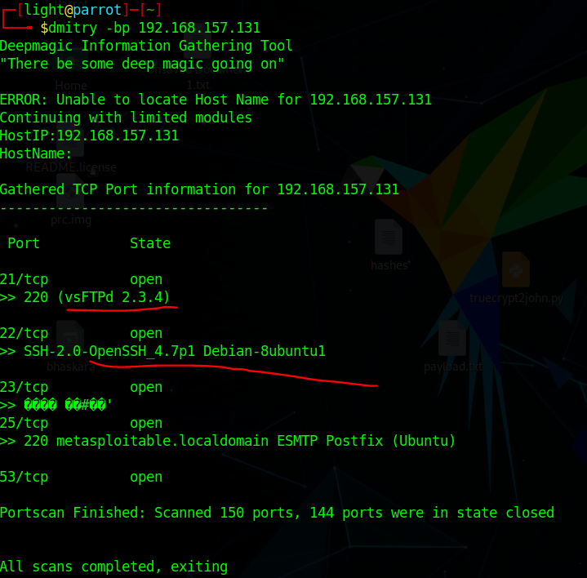
DMitry
It can help you get all the information possible from a remote host, including DNS enumeration, subdomain mapping, open ports and much more
Syntax:-dmitry –bp IP

Slide 11
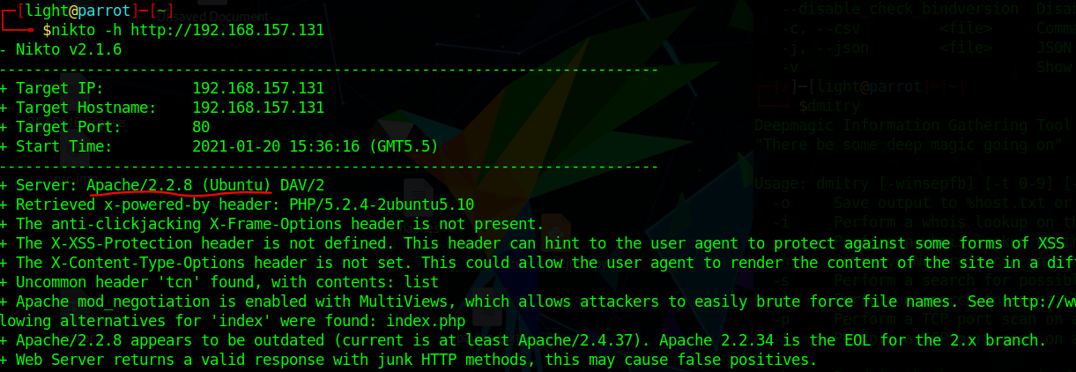
Nikto
Nikto is an open-source web-application scanner, which we’ll be using to grab a banner of a website running on an Ubuntu server.
nikto –h http://IP

Slide 12
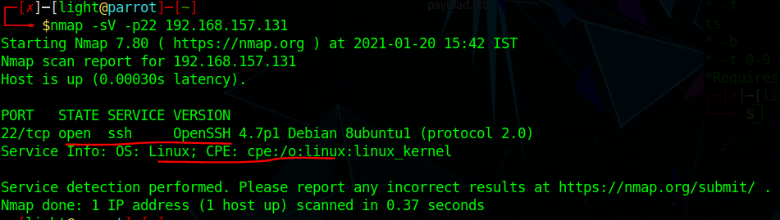
Nmap
Nmap can used as a Banner Grabbing tool.
Syntax:- nmap –Sv –p PORT IP

Slide 13


